Slide 1

The Insect Gas Exchange System

Slide 2
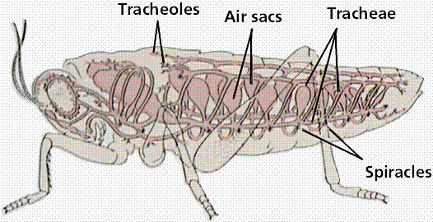
The Insect Gas Exchange System

Slide 3
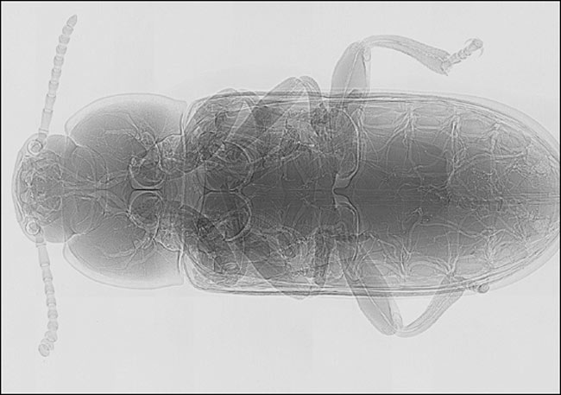
An X-ray of the yellow mealworm beetle - revealing the system of white tubes or tracheae running through its body

Slide 4
The Insect Gas Exchange System
An insect has spiracles (openings) lined with chitin on the sides of its body.
The chitin give shape to the openings.
The spiracles can open and close by small muscles.
These muscles contract to shut flap like valves and relax to open the valves – allows control of the flow of air as well as slow down the loss of water.

Slide 5
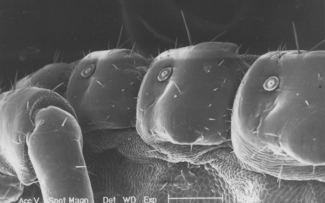
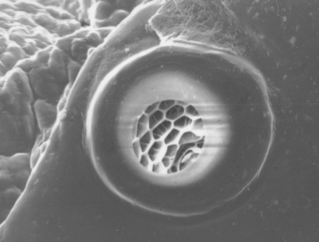
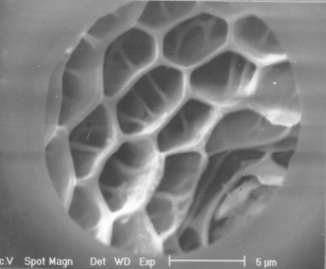
spiracles
Zoom
Zoom
The spiracles open into a system of tubes called tracheae

Slide 6
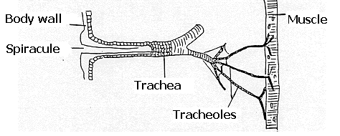
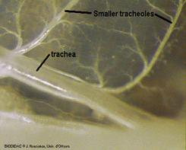
Tracheal System
Outside air
spiracles (openings)
Tracheae
Tracheoles
Trachea walls are reinforced with Taenidiae (thickening of the chitin) – allows insects to flex and stretch without developing kinks that might restrict air flow.

Slide 7
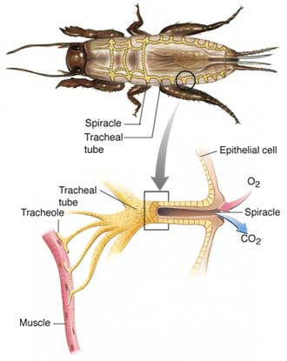

Slide 8
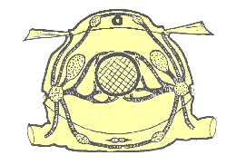
Storage of Air – adaptation for dry habitat
Collapsible air sacs present in areas without taenidiae
In dry terrestrial environments, this temporary air supply allows insects to conserve water by closing it spiracles during very dry periods use the stored air in the sacs.

Slide 9
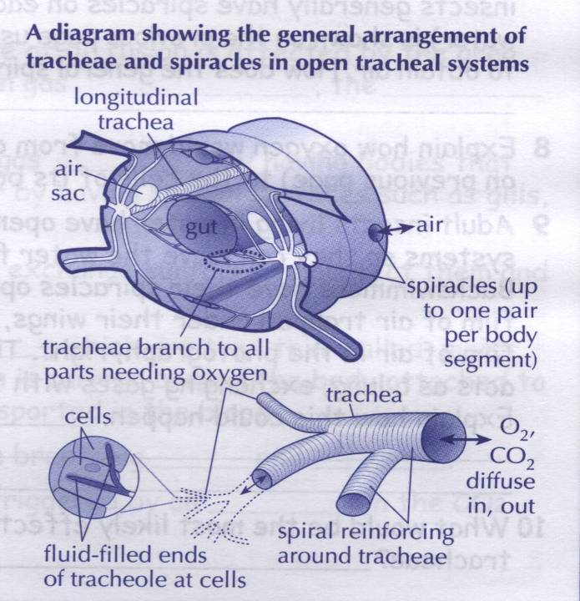

Slide 10
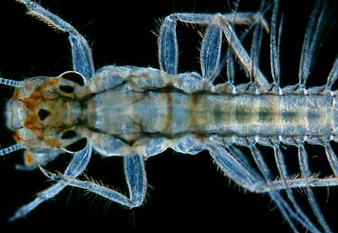
Respiratory tubes in a mayfly larva

Slide 11
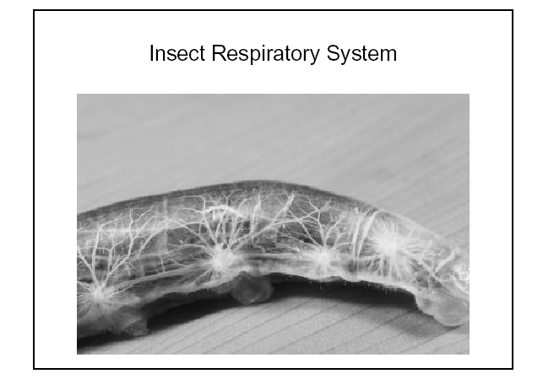
Tracheoles
Trachea lead to smaller tracheoles.
The ends of each tracheole finishes in a group of body cells.
The ends are lined with a thin moist surface (membranes) where the exchange of gases can take place.
The thin membranes are surrounded by watery haemolymph.
The body cells are bathed in the haemolymph.

Slide 12
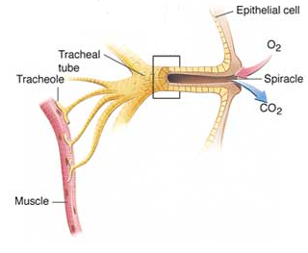
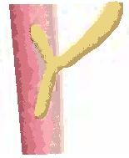
Passive Diffusion of Gases
Oxygen from the air in the tracheoles dissolves into the haemolymph fluid on the thin moist membrane surface and diffuses into the cells.
O₂ diffuse from tracheoles into haemolymph from a high concentration of O₂ to a lower concentration of O₂.
CO₂ produced by cell respiration can diffuse from the cells into haemolymph into tracheoles from a high concentration of CO₂ to a lower concentration of CO₂.
CO₂
O₂
CO₂
O₂
O₂
CO₂
O₂
O₂
O₂
tracheole
Cells covered with haemolymph

Slide 13
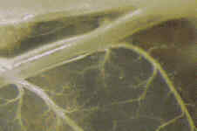
Increased Surface Area for Gas Exchange
Extensive network of trachea and tracheoles ↑’s surface area exposed for diffusion of:
O₂ into haemolymph and further to the body cells.
CO₂ out of cells into haemolymph into tracheoles.

Slide 14

Thin Surface for Gas Exchange
Thin surface to endings of tracheoles ↓’s the barrier to diffusion of:
O₂ into haemolymph and further to the body cells.
CO₂ out of cells into the haemolymph into the tracheoles.
Cells
Tracheole
Haemolymph
Zoom

Slide 15
Moist Surface for Gas Exchange
Moist surface at end of the tracheoles is important for:
O₂ to dissolve into the watery substance for diffusion into the haemolymph.
CO₂ to dissolve into the water substance for diffusion out of the haemolymph into the tracheoles

Slide 16
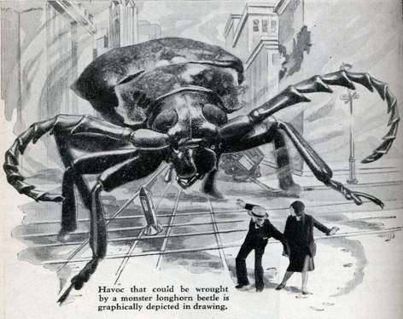
What Prevents Insects from being the Size we see in the Horror Movies?
Insects rely upon passive diffusion and physical activity for the movement of gases within the tracheal system.
Diffusion of O₂ and CO₂ through the air in the tracheal tubes is fast enough only for distances less than 1cm for the body surface. This limits the size/radius of the insect’s body.
Larger organisms use a blood circulatory system (blood vessels) to over come this limitation.

Slide 17
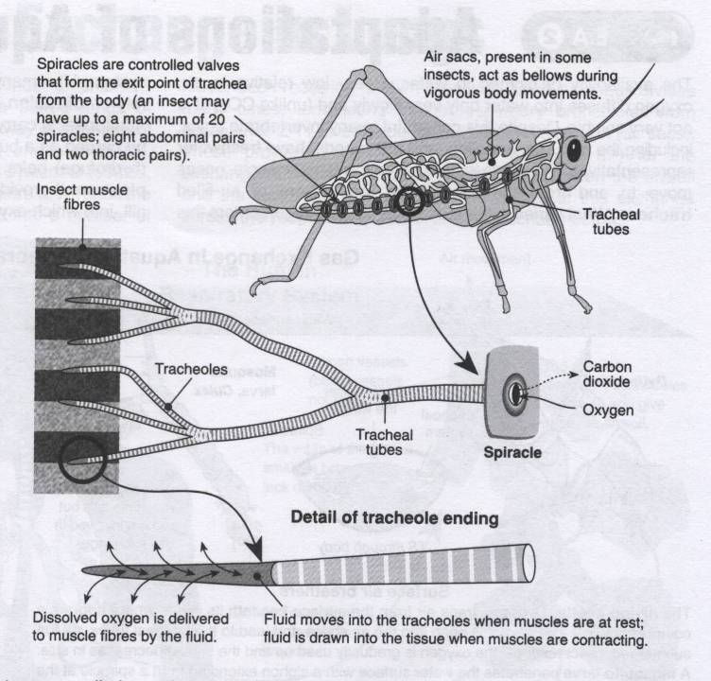

Slide 18
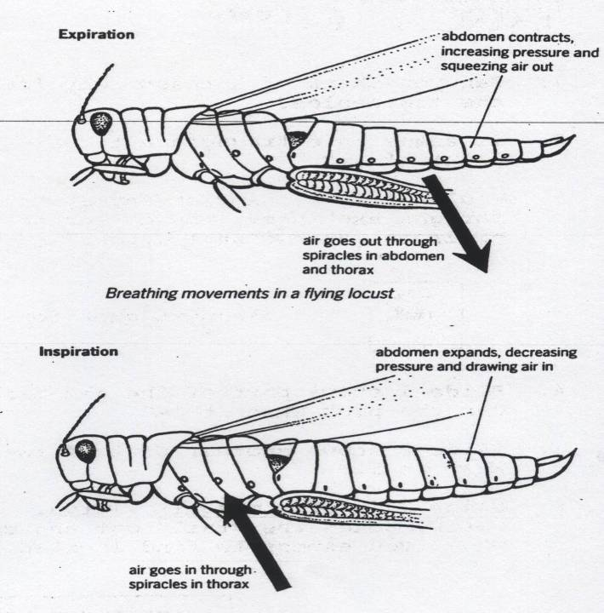

Slide 19
